Slide 1


Slide 2
TEAM LEADER G. ILAYARANI B.SC., Physics Shree Raghavendra Arts and Science College

Slide 3
TEAM MEMBERS M. DHARSHINI B. DHIBAKAR T. HARITHA V. PURSHOTHAMAN B.Sc., Physics Shree Raghavendra Arts and Science college

Slide 4
UNLOCKING INSIGHTS INTO THE GLOBAL AIR TRANSPORTATION NETWORK WITH TABLEAU

Slide 5
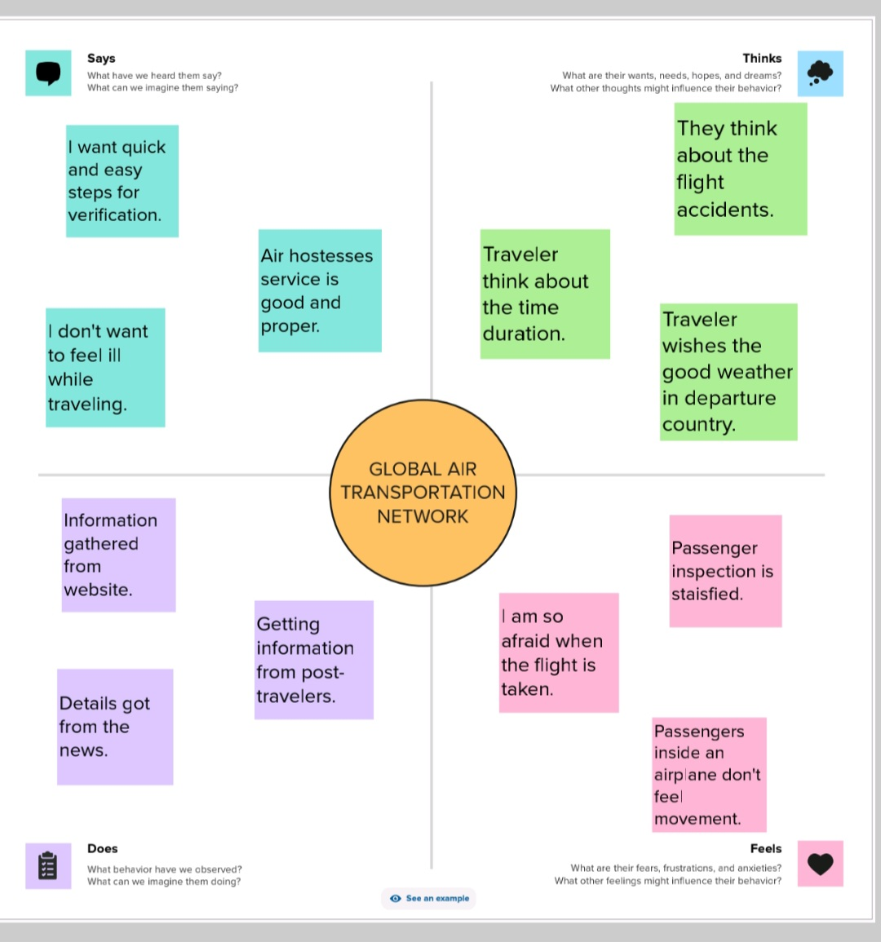
EMPATHY MAP

Slide 6
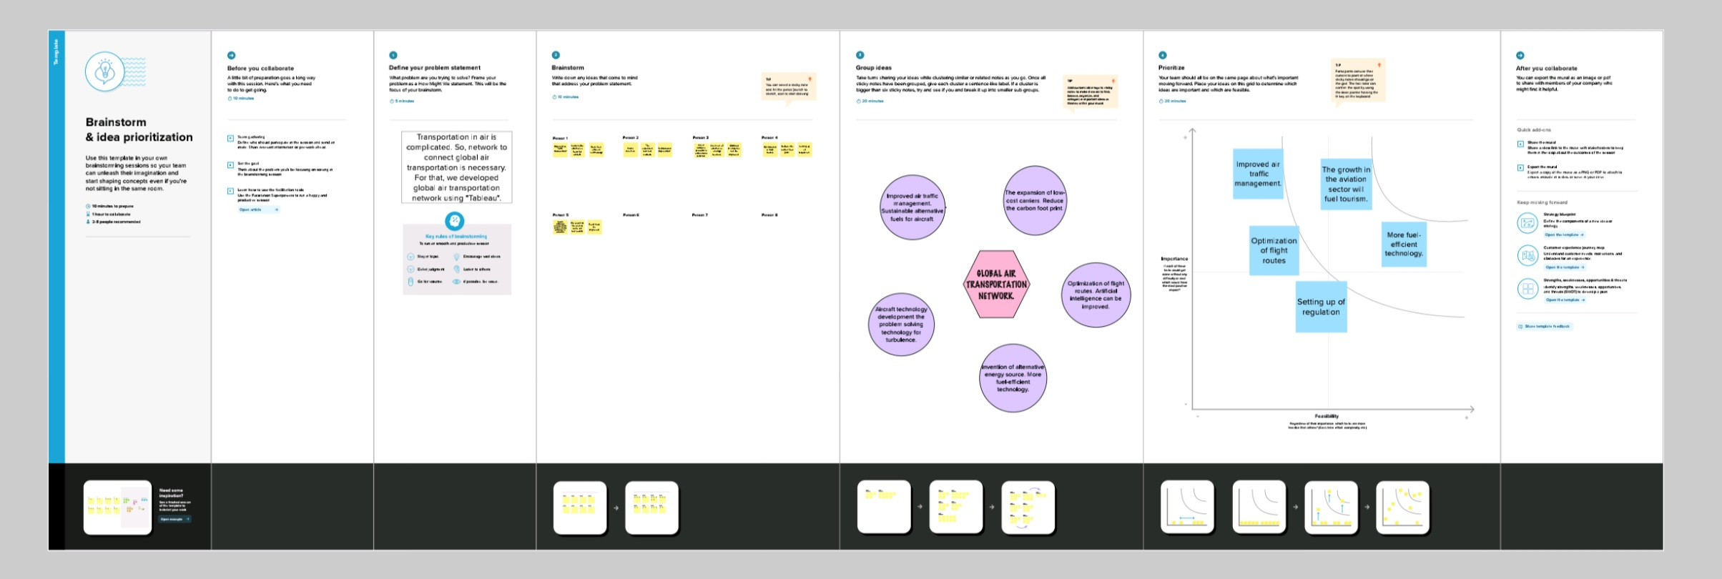
BRAINSTORMING MAP

Slide 7
5 SHEETS ABOUT THE PROJECT

Slide 8
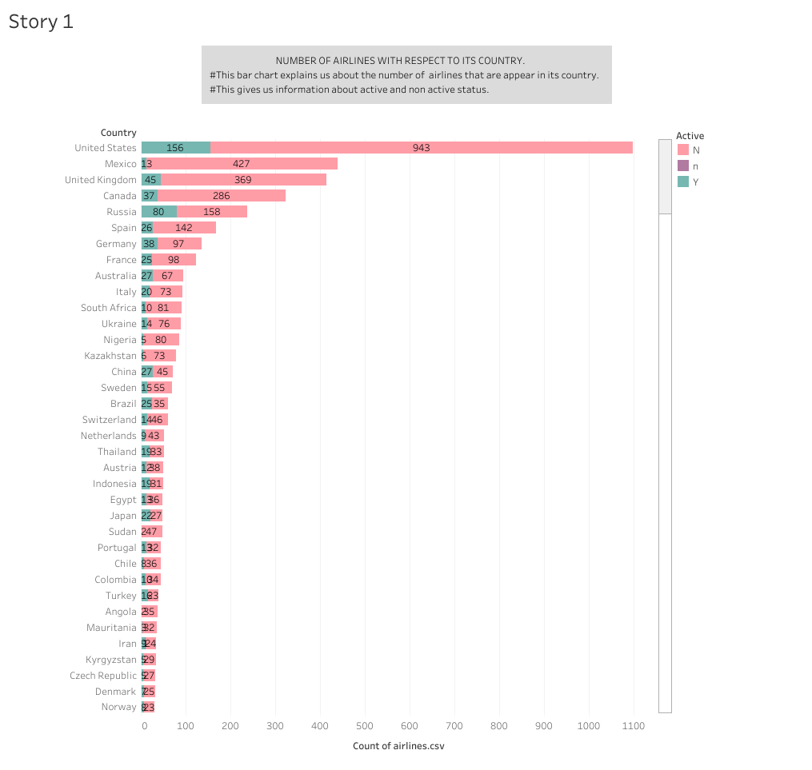

Slide 10
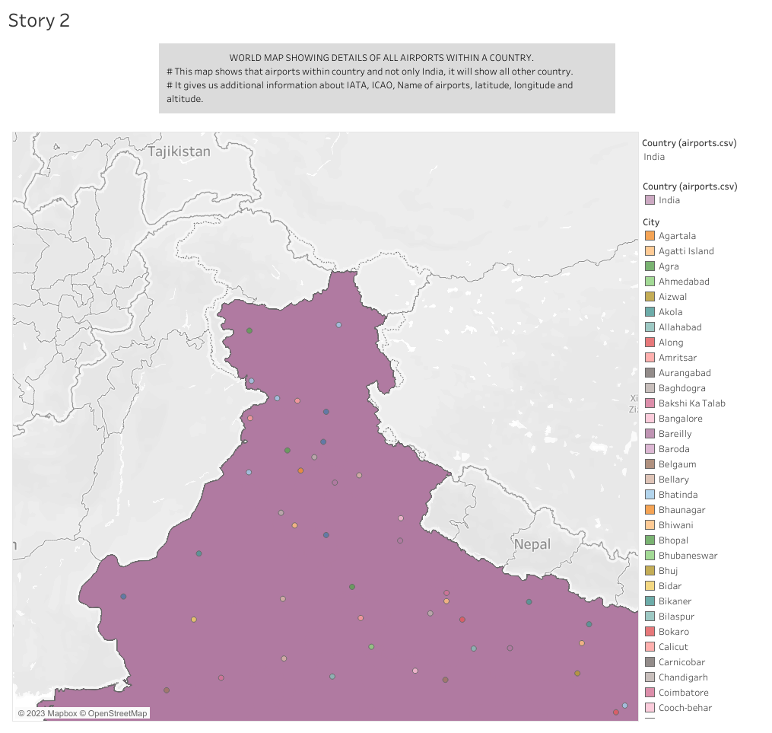

Slide 11
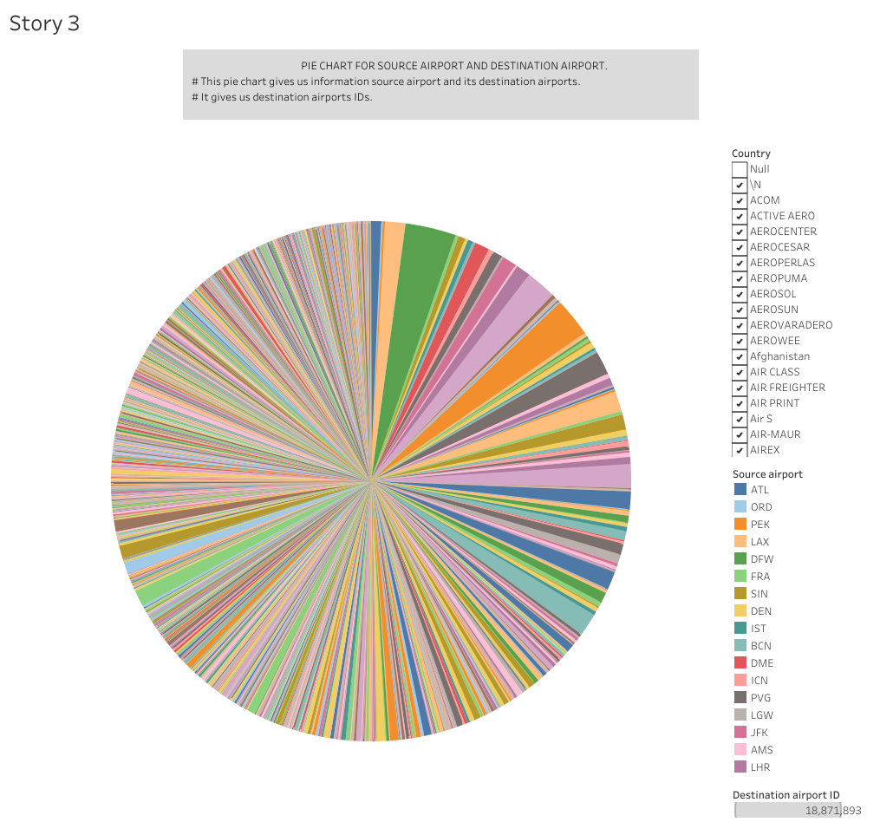

Slide 12
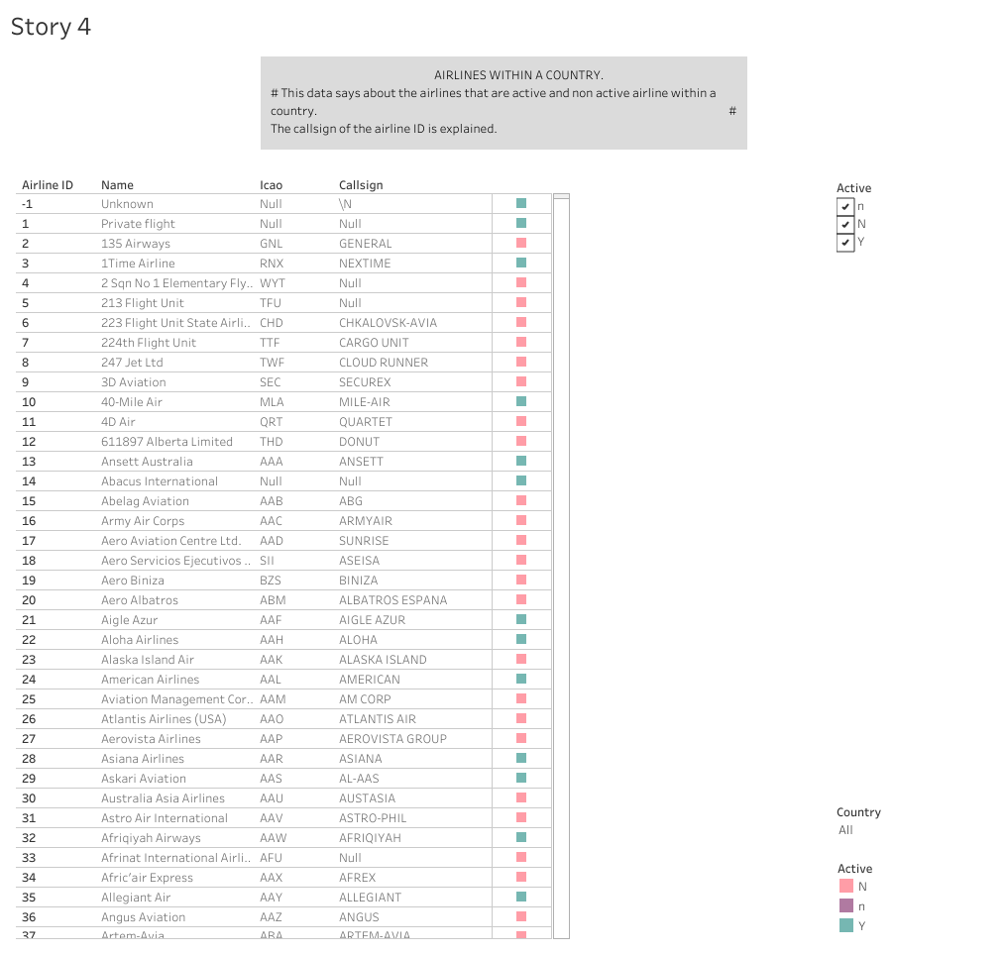

Slide 13
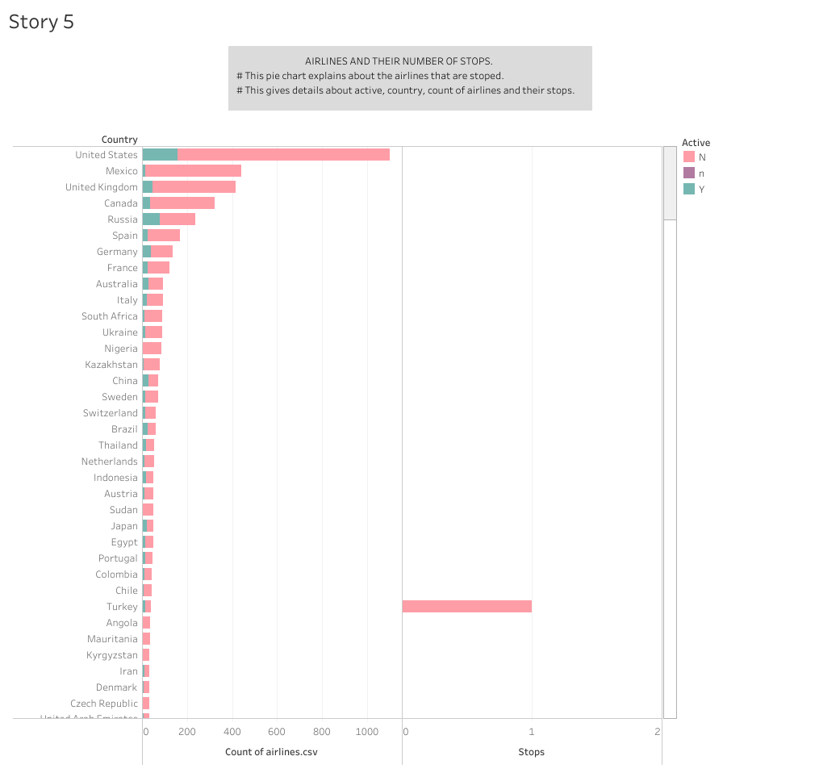
Story 5

Slide 14
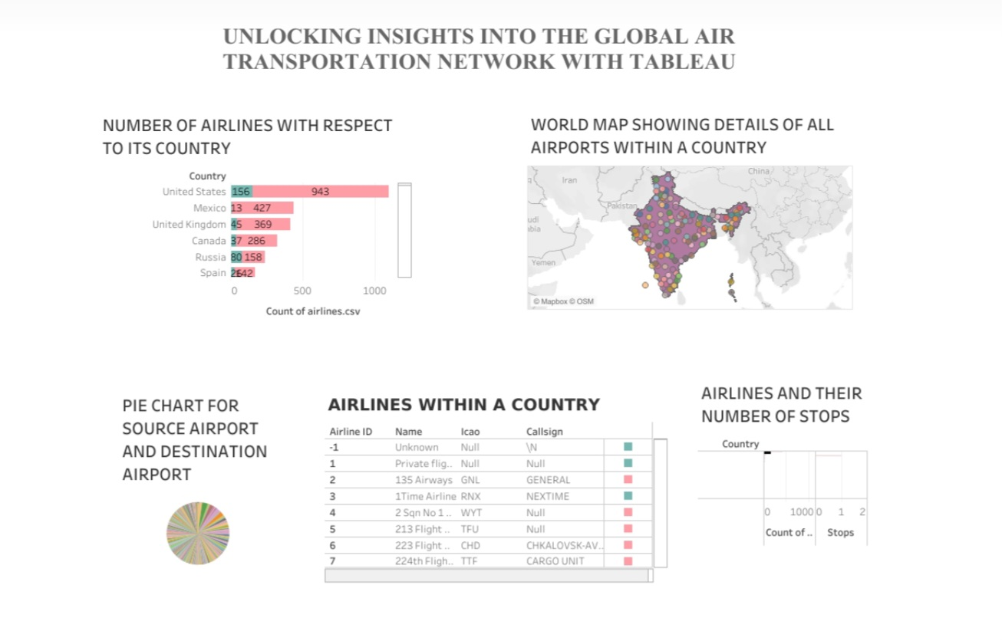
DASHBOARD

Slide 15


